Slide 1
DTT UIX Design
Kiosk Project
Group 9: Layla, Yusri, Farhan & Chee Leong

Slide 2
Upcoming Contents
Company Selection | Choosing the right company.
User Interview | Gathering Information and Opinions With Peers.
Empathy Map | Understanding and Mapping Information out with current Customers and/or Peers.
Pov | Acknowledging Problems with Mr Coconut Kiosk and Noting Ways to Improve.
StoryBoard | A Storyline of Users using the Kiosk.
Prototype | Showcasing our Updated and Improved UIX.
Group 9
Notes:
FARHAN

Slide 3
01
Company Selection
Group 9
Notes:
FARHAN

Slide 4
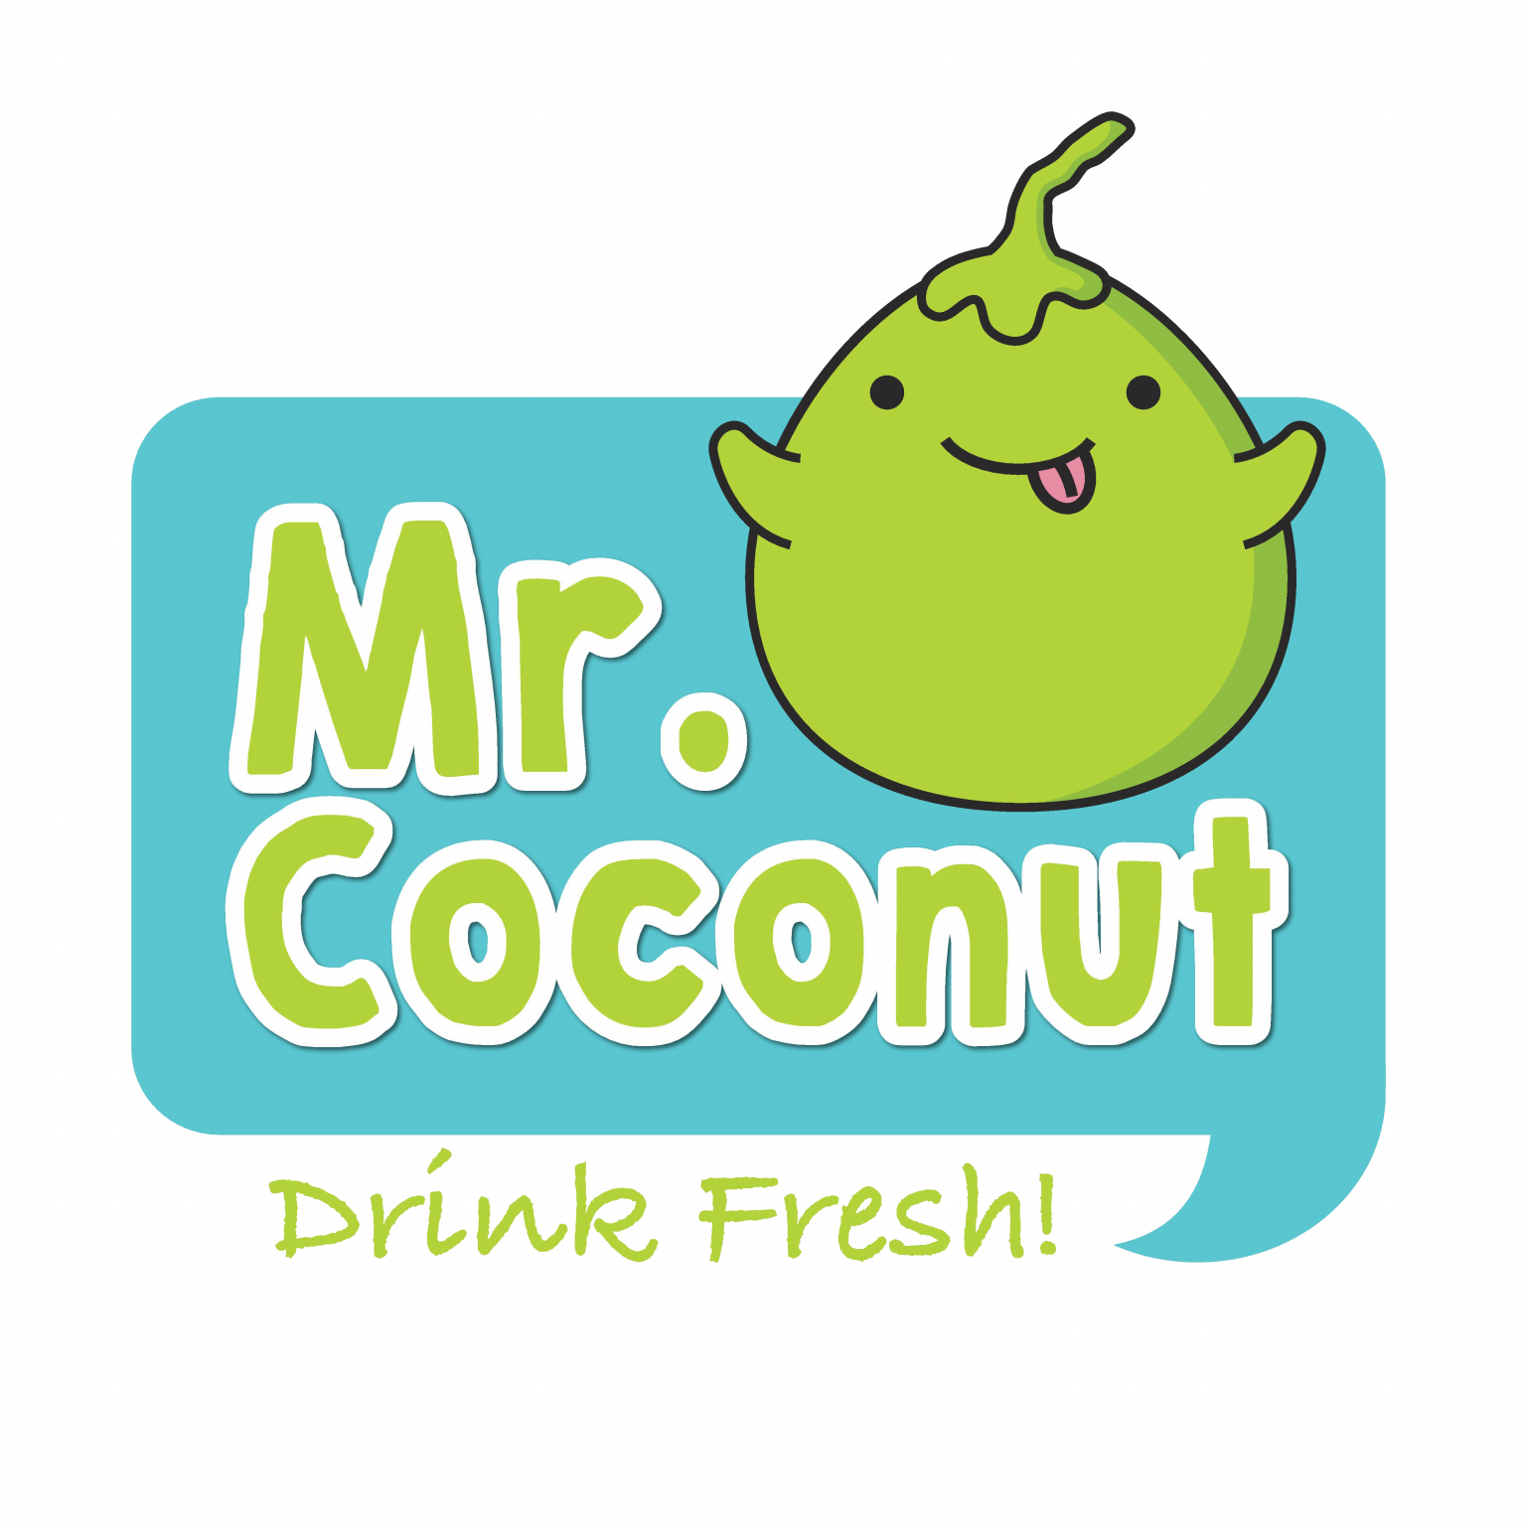

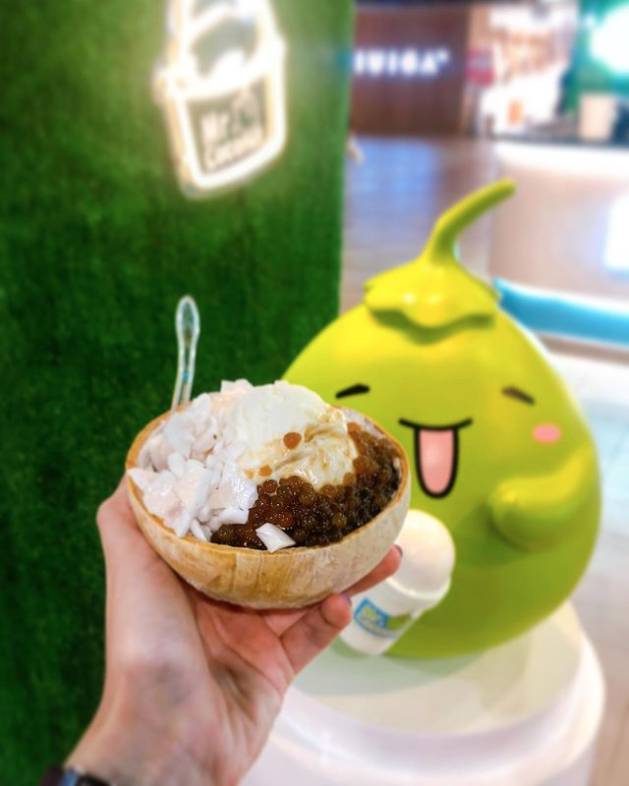
Mr. Coconut
Background:
Mr Coconut, a Singapore-based drink company, has been serving a variety of ice-blended coconut drinks since 2016. With over 30 outlets and ongoing expansion, they are a popular choice among locals.
Reason:
We chose Mr Coconut for our project because we see opportunities to improve the user interface of their self-checkout kiosks. As fans of the brand, we believe we can enhance the kiosk design to be more user-friendly for a broader customer base.
Group 9
Notes:
FARHAN

Slide 5
02
User Interview
Group 9
Notes:
LAYLA

Slide 6


02
Softwares Used
Group 9
Notes:
LAYLA

Slide 7
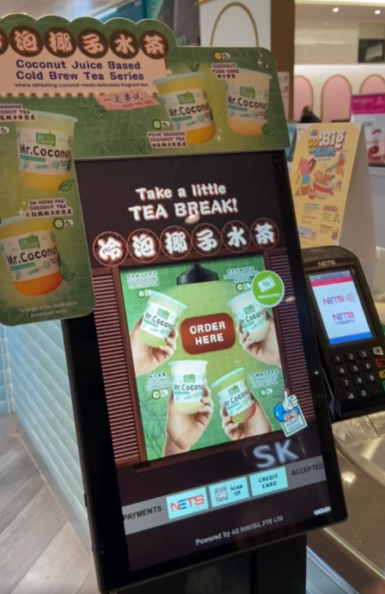
User Interview
Explanation:
During the user interview stage, we opted for a Google Form to reach a wider audience. This approach allowed us to gather feedback from 27 people who have used Mr Coconut. We focused on identifying areas where the kiosk system could be improved.
Statistics:
Out of 27 respondents,
15 had used Mr Coconut's kiosk.
7 were satisfied with the kiosk.
5 wanted better responsiveness.
2 suggested more vibrant colors.
1 requested the option for cash payments.
Group 9
Notes:
LAYLA

Slide 8
03
Empathy Map
Group 9
Notes:
CHEE LEONG

Slide 9
Empathy Map
01
02
03
Think & Feel
See
Hear
After school, many enjoy Mr. Coconut as a reward, associating it with a sense of accomplishment.
The kiosk offers a peaceful way to unwind without additional interactions.
At Jurong Point, customers eagerly queue at Mr. Coconut's kiosk, pay, and wait in a designated area for their refreshing drinks.
The sounds of blenders and friendly chatter create a lively and welcoming atmosphere as staff efficiently prepare orders.
Group 9
Notes:
CHEE LEONG

Slide 10
Empathy Map
04
05
06
Say & Do
Pain
Gain
At the Mr. Coconut kiosk, customers quickly pay at self-service stations, collect loyalty cards, and check their order numbers on a screen for efficient drink collection.
During rush hour, longer waiting times occur due to increased customer volume, leading to slower service and less efficiency.
Brand loyalty shines as customers appreciate the efficient, consistent process, with many returning for the reliable service and quality they expect.
Group 9
Notes:
CHEE LEONG

Slide 11
04
Point Of View
Group 9
Notes:
FARHAN

Slide 12
POV: Opportunities for Improvement
UI Improvements for a Wider Audience:
- Enhance interface smoothness with better transitions.
- Simplify navigation to make it user-friendly for all ages.
- Replace vague animated toppings with clear images.
- Reorganize product layout so sold-out items automatically move to the bottom.
- Add functional buttons and a taskbar to display the total price of items in the cart.
Notes:
yusri

Slide 13
05
Ideation
Group 9
Notes:
YUSRI

Slide 14
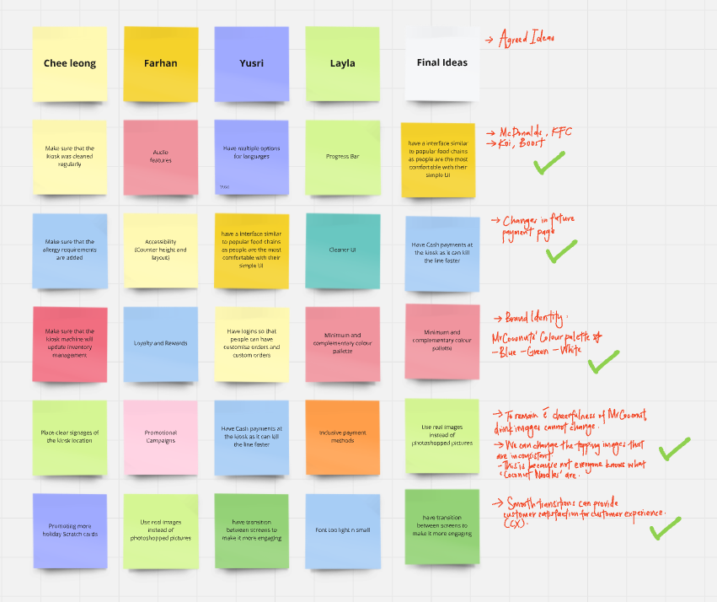
05
Group 9
Notes:
YUSRI

Slide 15
06
Storyboard
Group 9
Notes:
FARHAN

Slide 16
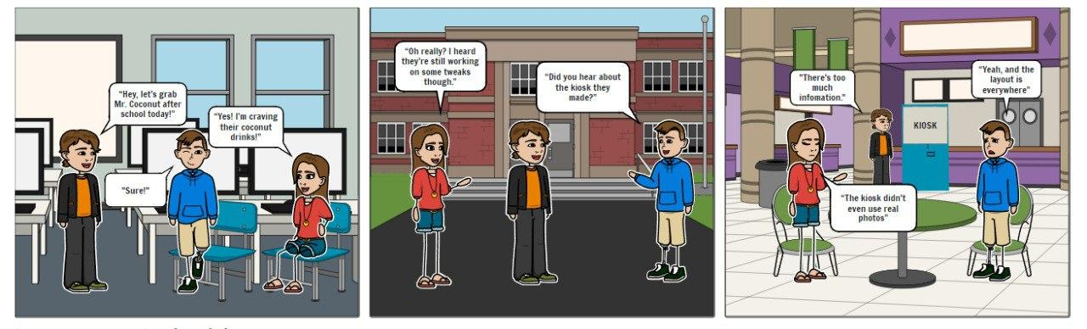
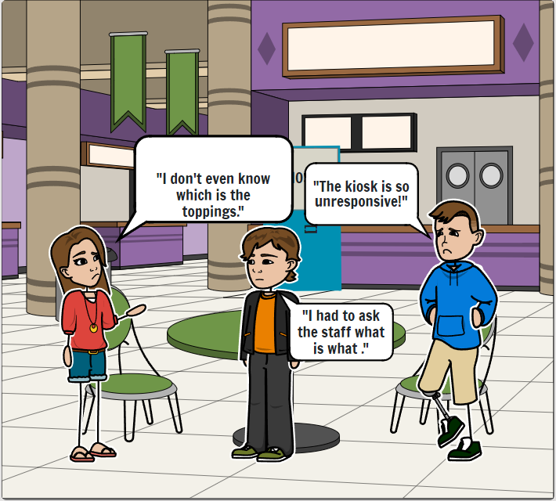
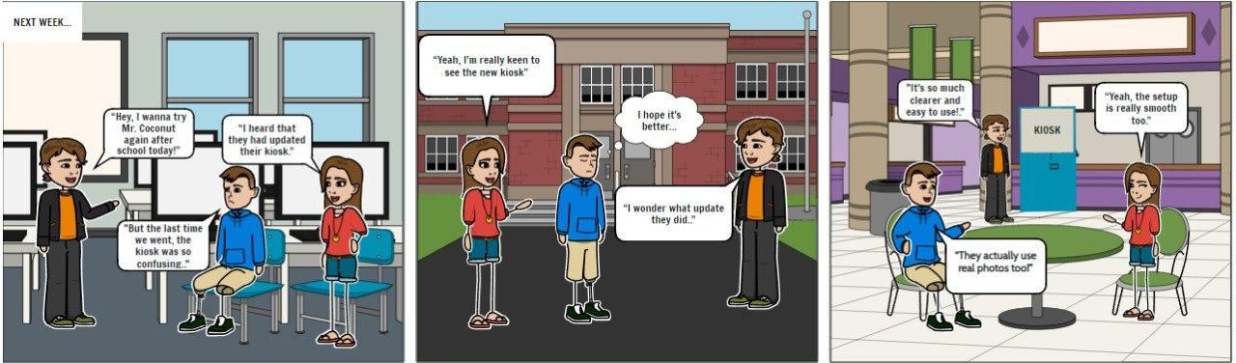
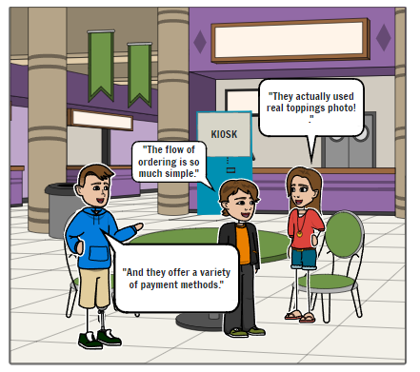
06
Storyboard
Group 9
Notes:
FARHAN

Slide 17
07
Prototype
Group 9
Notes:
ALL

Slide 18
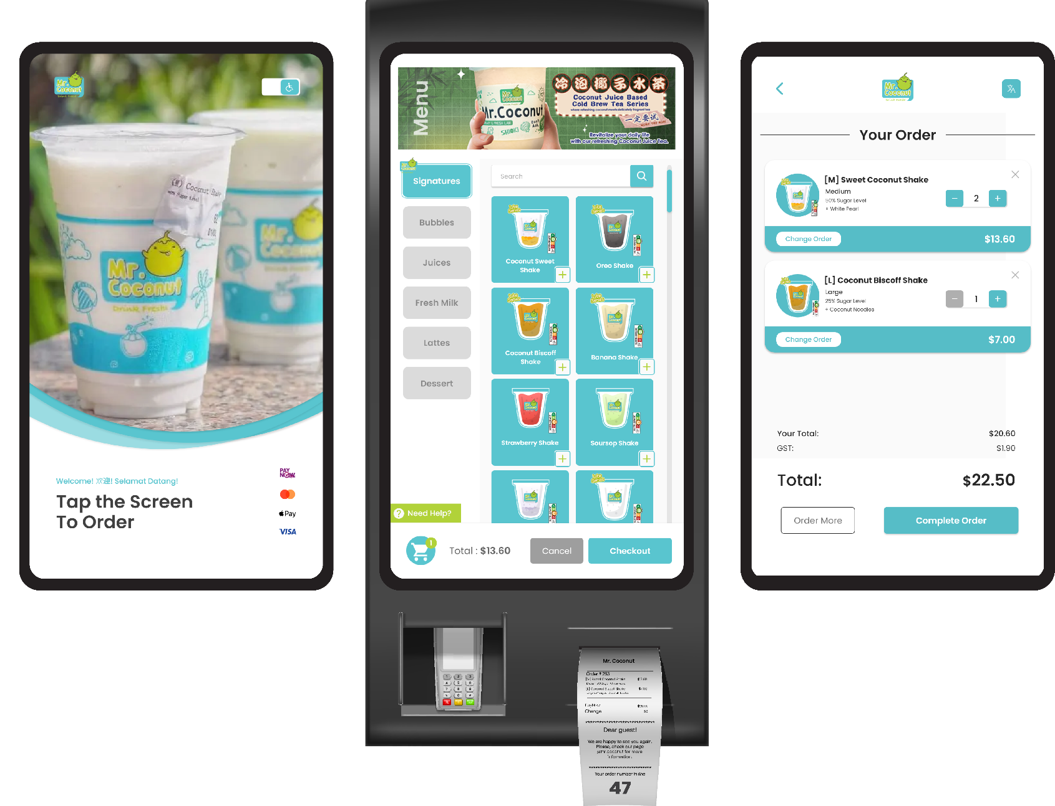

Notes:
ALL

Slide 19


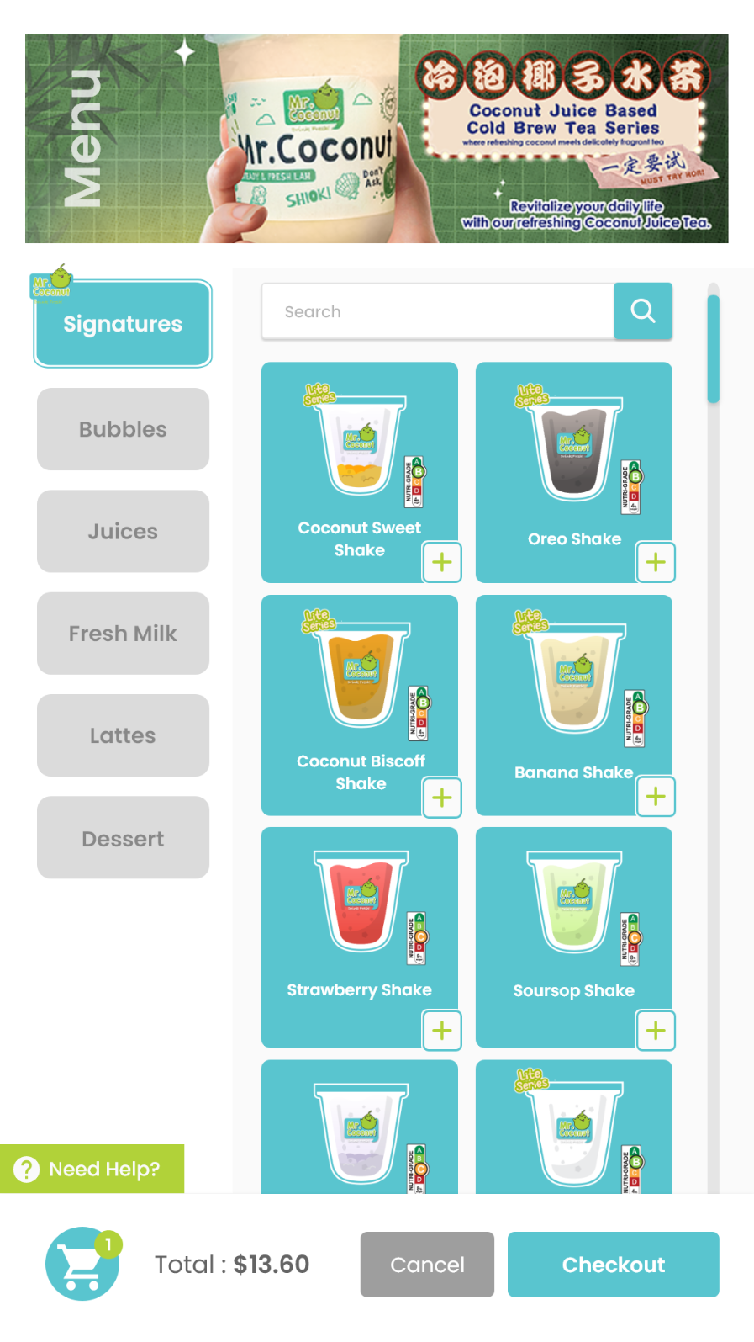
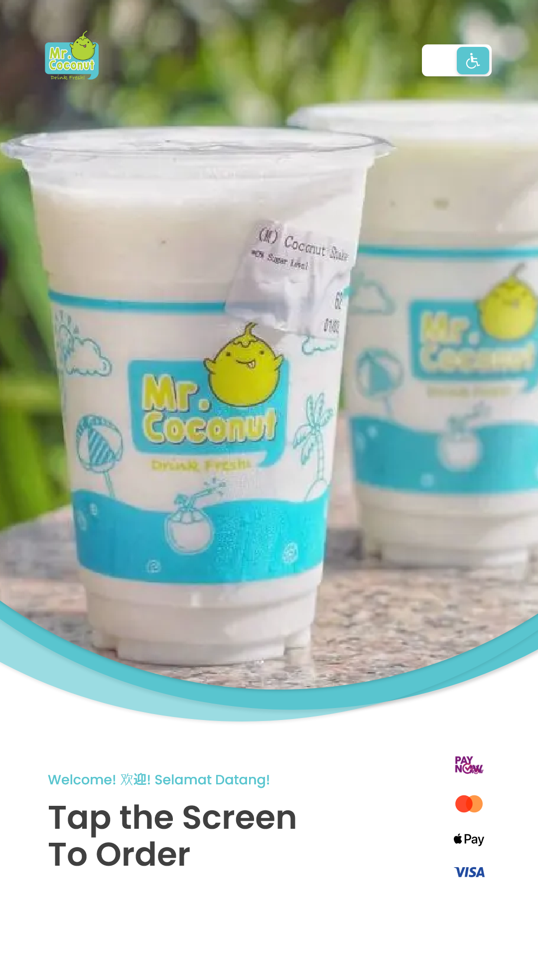
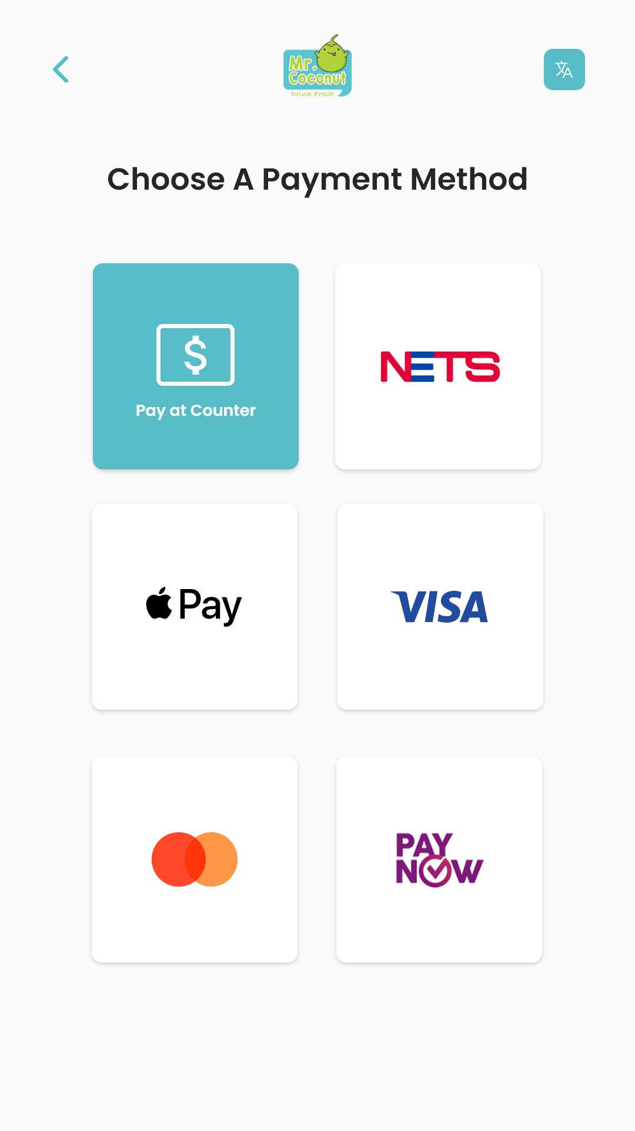
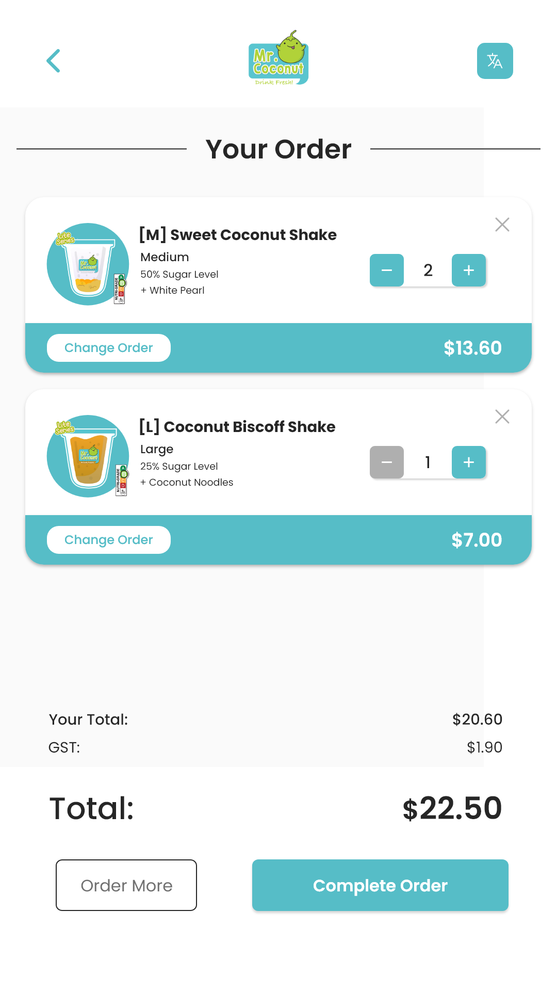
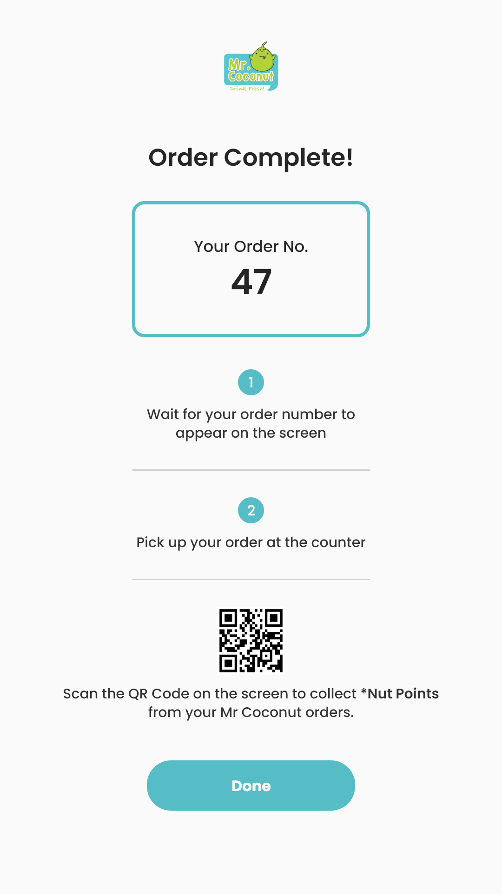
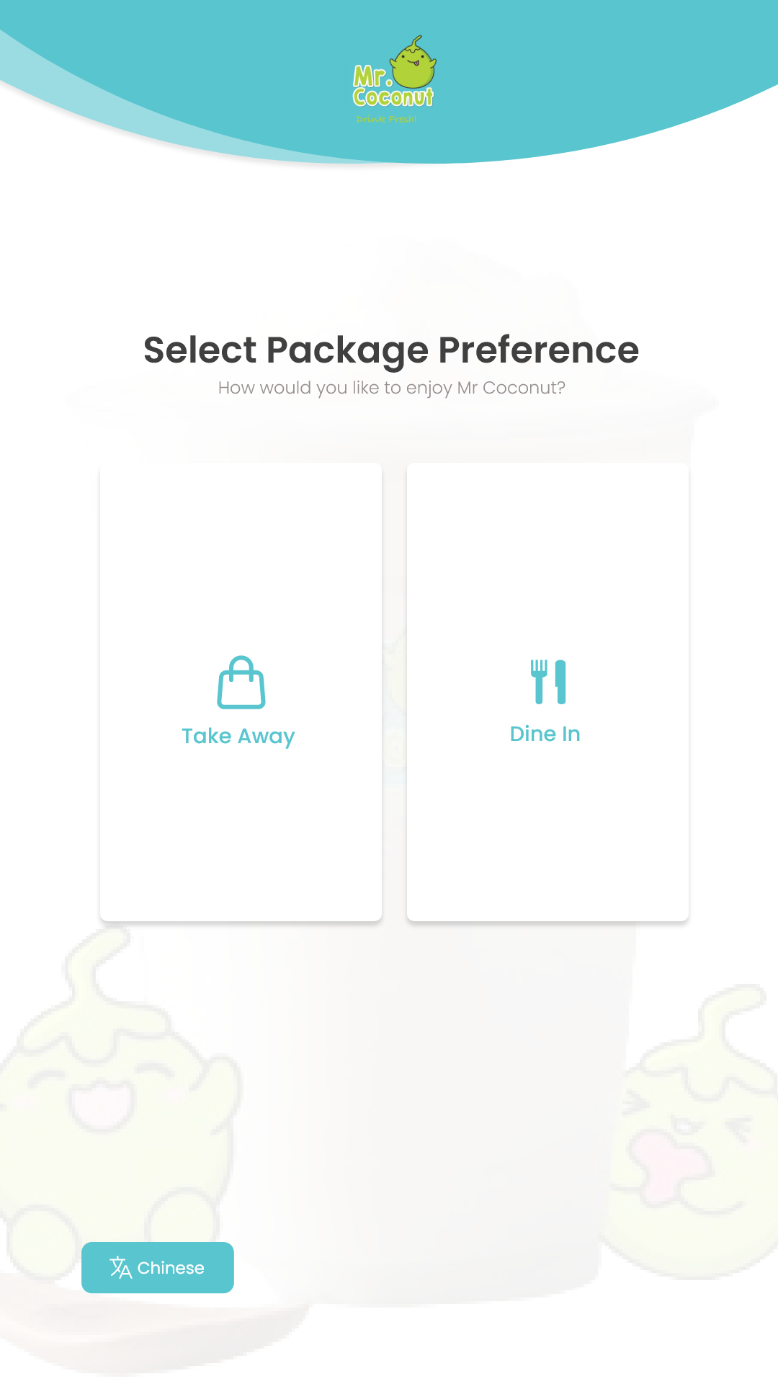
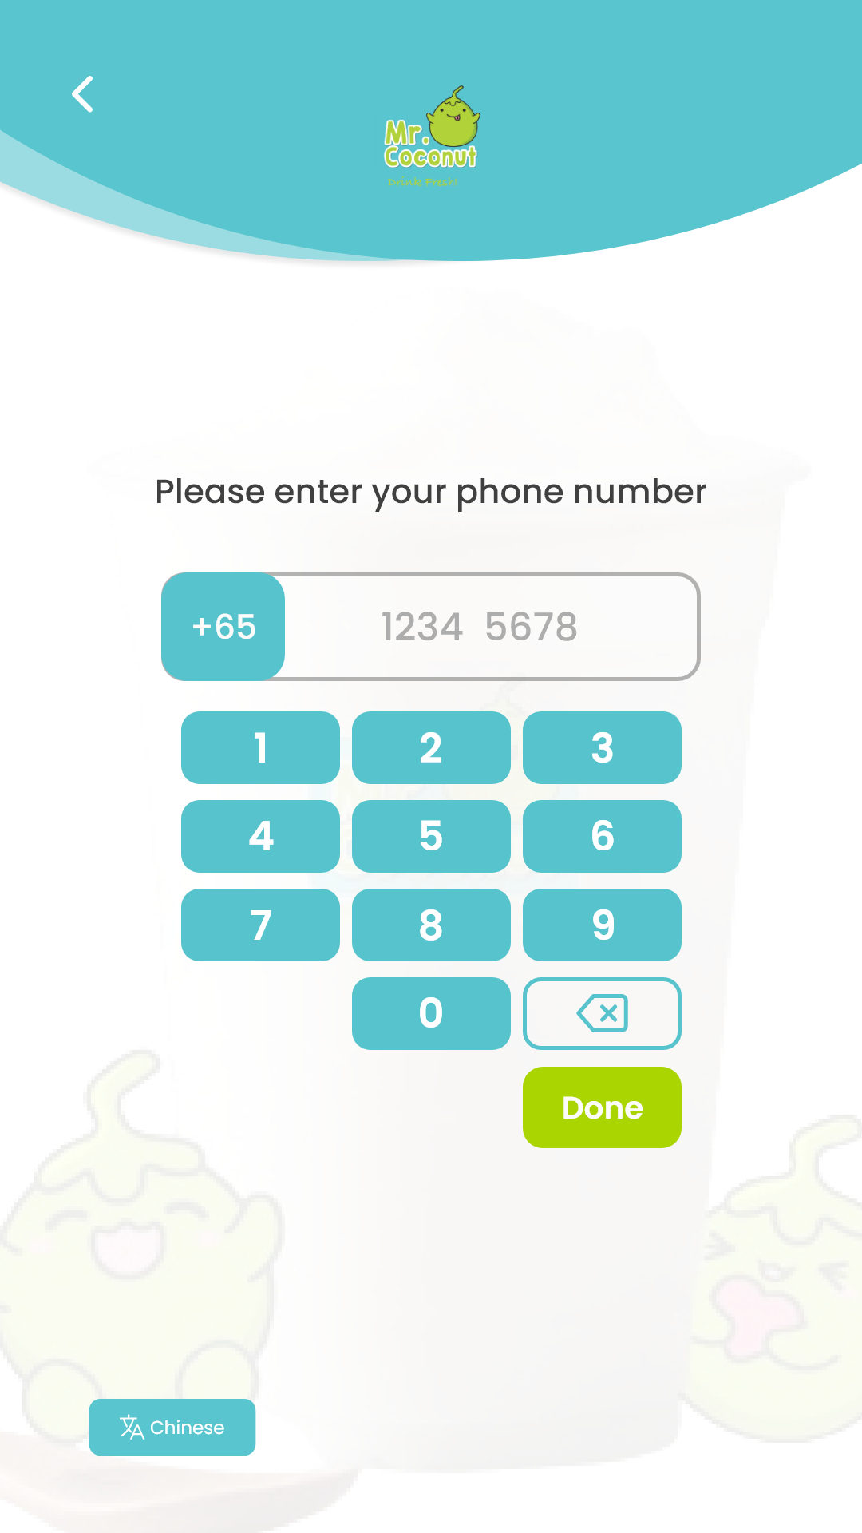
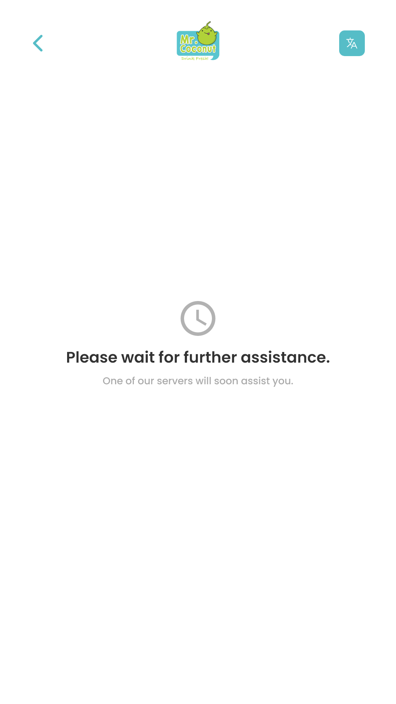
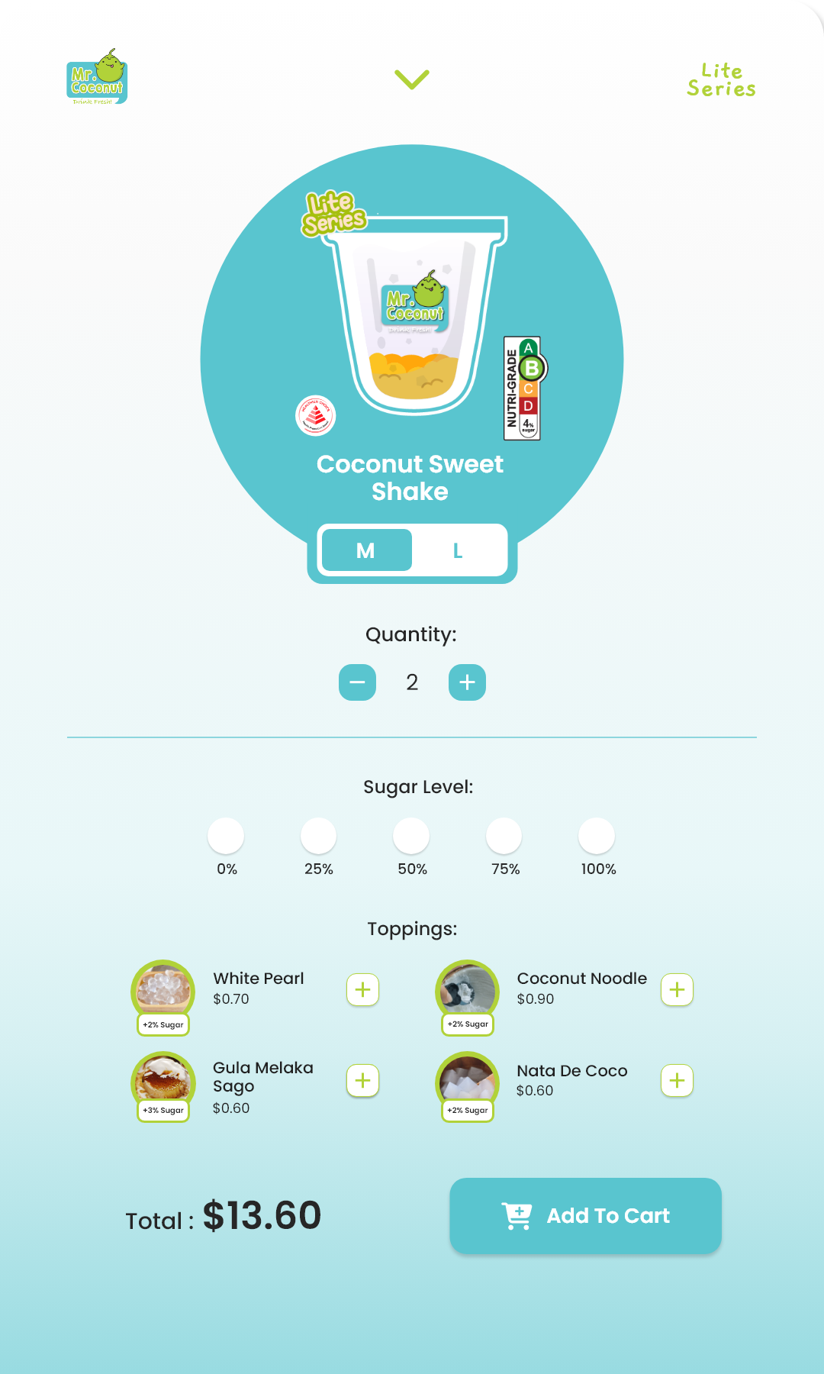
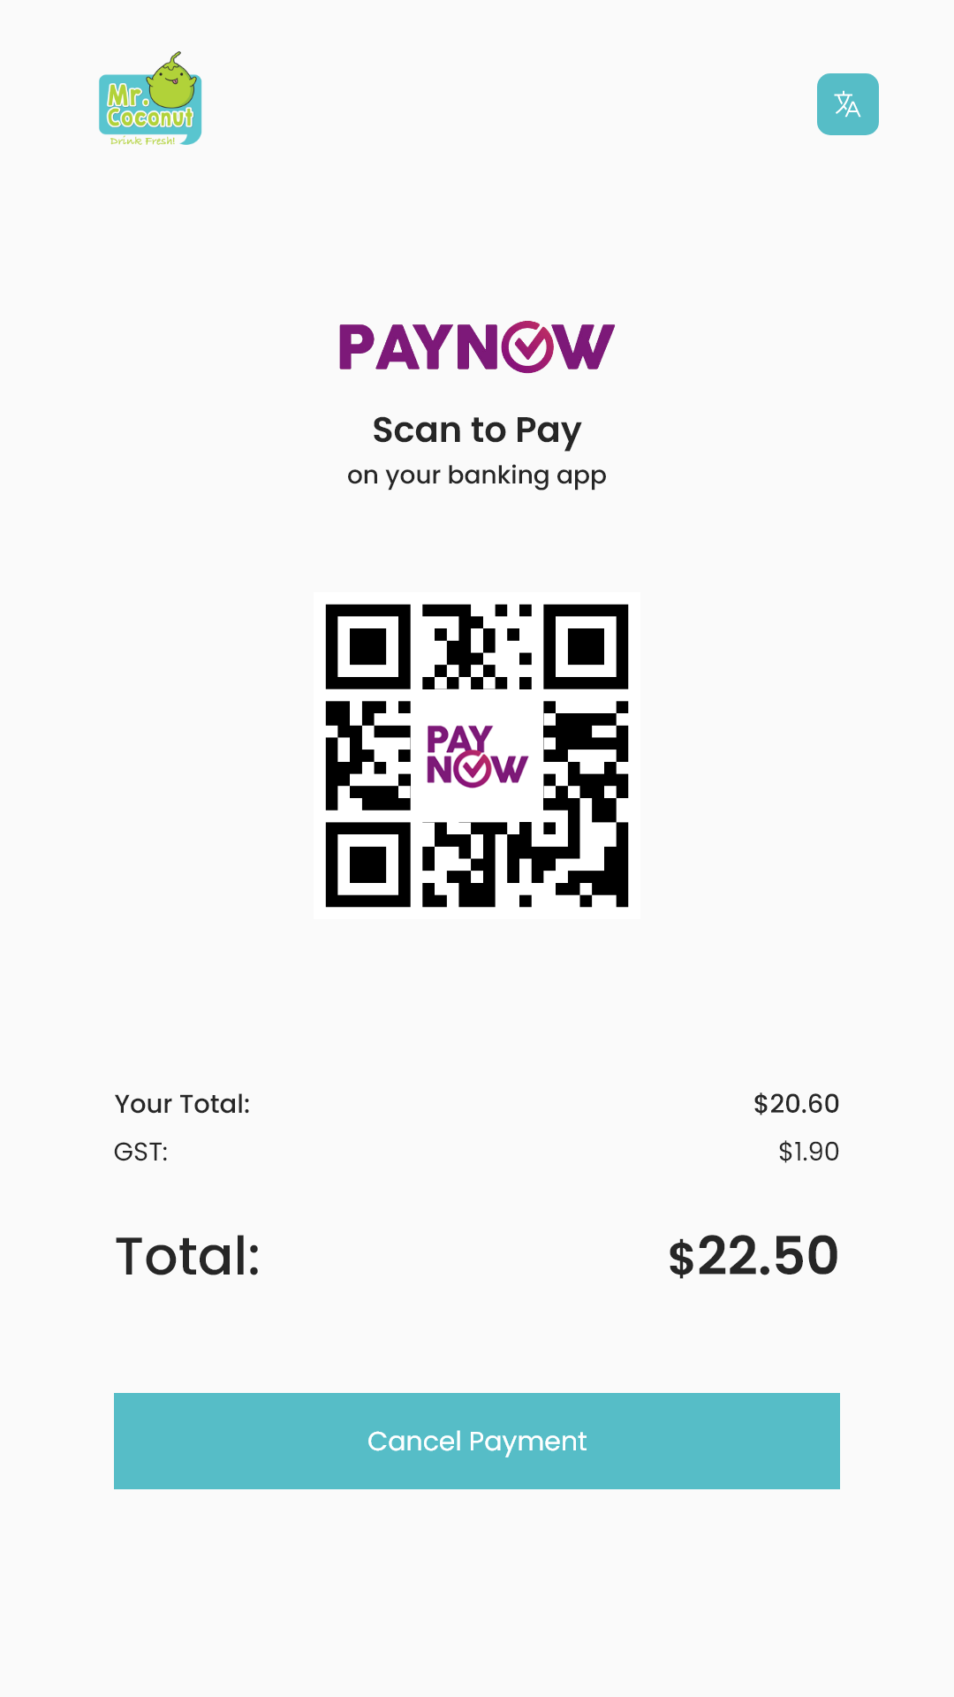
Notes:
ALL

Slide 20
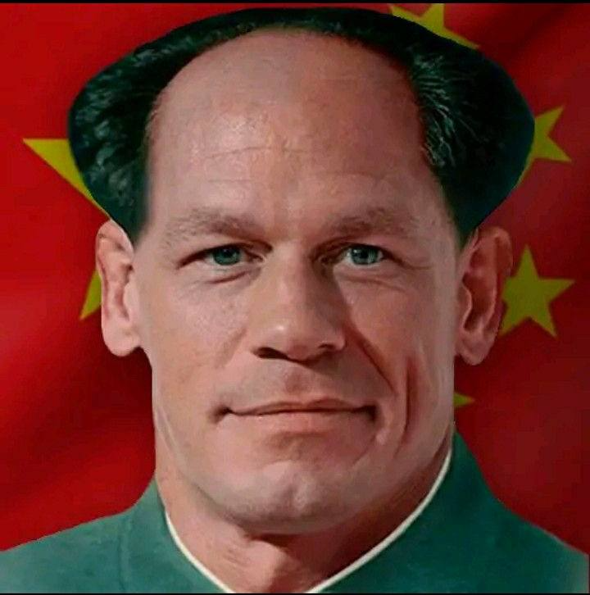

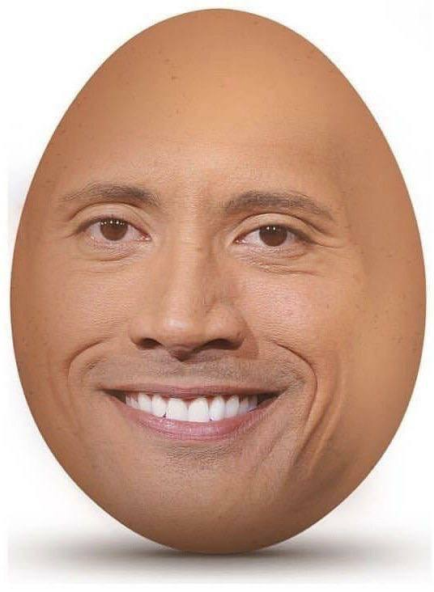
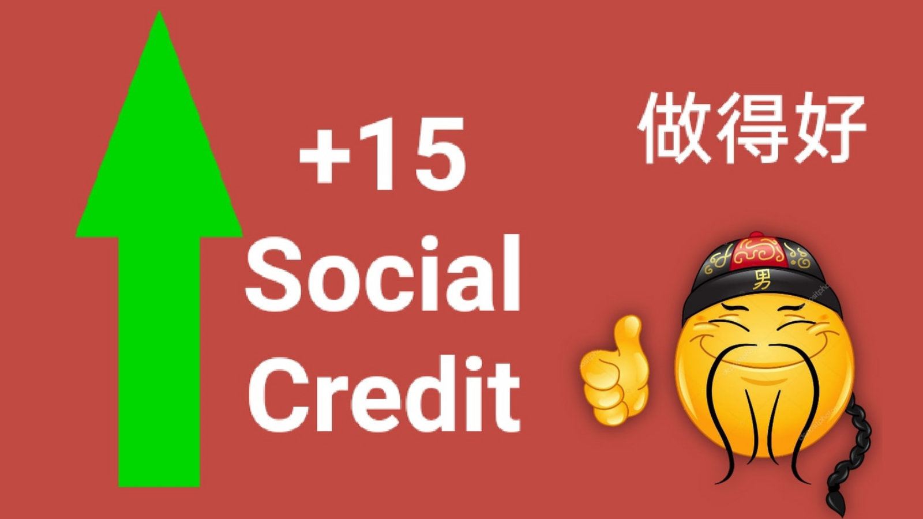
THANK YOU!!
Group 9
Notes:
ALL

